Slide 1


A Comparative Study of Monolithic and Modular Architectures
In a Dataset Driven Case Tracking Web Application
Mireya Francesca Vella
Bachelor of Science (Honours) in Creative Computing

Slide 2
Hypothesis & Research Questions
Hypothesis
A modular or layered architecture is more maintainable and testable than a monolithic architecture.
RQ1
RQ2
RQ3
RQ4
Does modular architecture reduce complexity vs monolithic?
Does modular architecture improve
test isolation and
mock precision?
Does architecture
type affect ingestion throughput or API latency?
Does architecture type affect how changes propagate through the codebase?

Slide 3

Literature Review
7 peer-reviewed sources across 3 interlocking themes
Architectural Smells & Maintainability | [1] Mumtaz et al. (2021) Systematic mapping — smell detection landscape [3] Sas et al. (2021) Co-change as a coupling and change-propagation proxy [6] Esposito et al. (2025) Smell indicators correlated with static analysis warnings
Modularity Measurement & Boundary Quality | [4] Pisch et al. (2024) M-score — empirically derived modularity metric [5] Su & Li (2024) Modular monolith as an architectural trend
Remodularisation & Change Impact | [2] Tan et al. (2023) REARRANGE — effort estimation for remodularisation [7] Schroeder et al. (2021) Search-based remodularisation at Adyen (industrial)

Slide 4
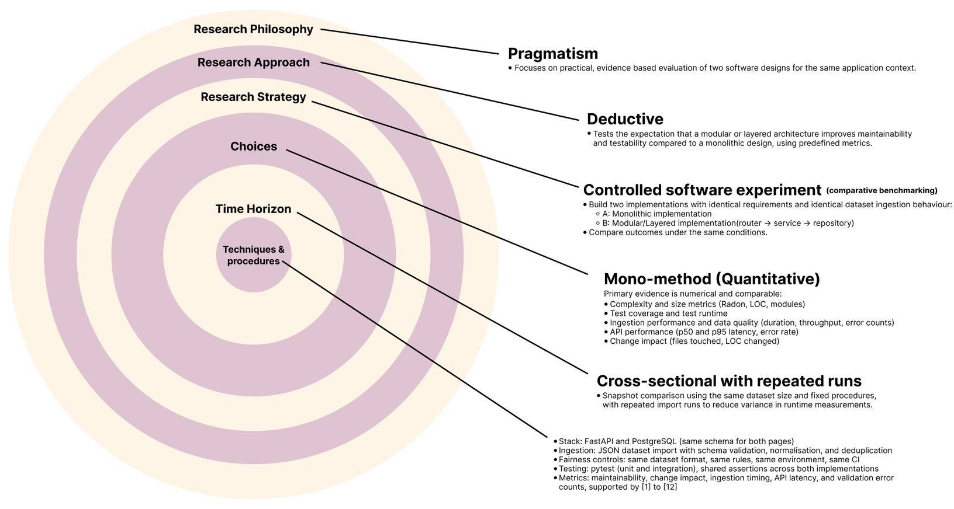
Research Design
Grounded in the Research Onion Framework

Slide 5

Experiment Design & Fairness Controls
Architecture A: Monolithic All routing, business logic & data access in a single main.py (632 LOC) | VS | Architecture B: Modular Router →Service → Repository across 6 dedicated files (857 LOC)
Fairness Controls (identical across both implementations)
Same DB schema & migrations |  | Same 5,000 record synthetic dataset |  | Same API contract & behaviour
Same 29-test pytest suite |  | Same CI environment
Dataset: Python script (generate_data.py) — 5,000 JSON records, 7 fields, fixed seed 42 for reproducibility. Used as sole input for both backends.

Slide 6
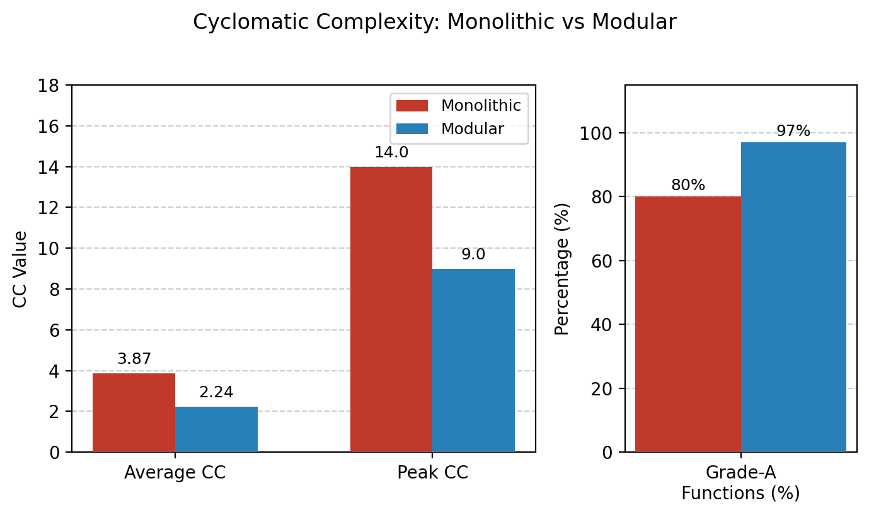
RQ1: Maintainability
LOC Distribution & Cyclomatic Complexity via Radon
Lines of Code
Monolithic: 632 LOC in 1 file
Modular: 857 LOC across 6 files (+35.6%)
Trade-off: explicit layer boundaries (Su & Li [5])
Lines of Code
Average CC: 3.87→ 2.24 (−42%)
Peak CC: 14 Grade C → 9 Grade B (−36%)
Grade-A functions: 80%→ 97% (+17 pp)
Lines of Code
Mono warning: line 379 of main.py (dense 632-line function)
Mod warning: services/cases.py:56 (layer obvious by filename)

Slide 7
RQ2: Testability
Shared 29-test API Contract Suite & Mock Injection Precision
Architecture A: Monolithic 29 / 29 tests passed 0 failures · 13 warnings Runtime: 0.39 s |  | Architecture B: Modular 29 / 29 tests passed 0 failures · 13 warnings Runtime: 0.53 s
Mock Injection Strategy
Concern | Monolithic target | Modular target (layer-boundary)
DB Connection | main.get_conn | routers.cases.get_conn
Bulk Insert | main.execute_values | repositories.cases.execute_values
Patch Accuracy | Module-level (broad) | Layer-boundary (precise)
Layer-boundary patching enables fault attribution to a specific architectural layer - a property monolithic design cannot offer without refactoring (Esposito et al. [6]).

Slide 8
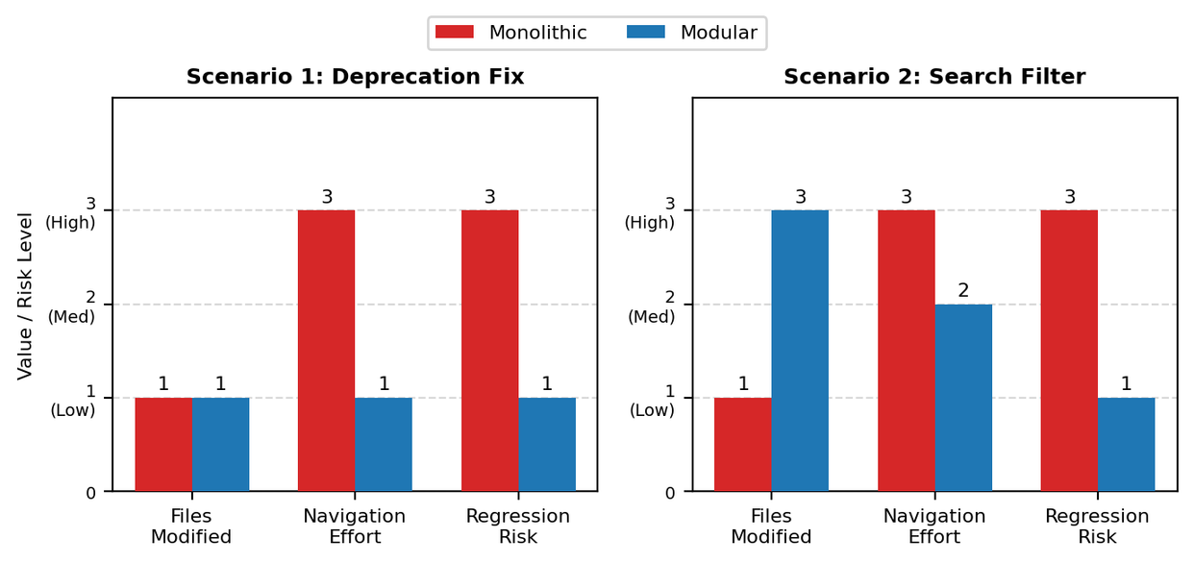
RQ3: Performance
RQ4: Change Impact
2 Controlled Scenarios
Proxy: pytest suite collection time (mocked DB)
Monolithic: 0.39s vsModular: 0.53s (+36%)
Attributable to 6 extra module imports, not logic
No structural performance penalty identified
Score Summary (1=Low, 2=Med, 3=High)
Dimension | S1 Mono | S1 Mod | S2 Mono | S2 Mod
Files Modified | 1 | 1 | 1 | 3
Navigation Effort | 3 | 1 | 3 | 2
Regression Risk | 3 | 1 | 3 | 1
Limitation
No live DB benchmark conducted (future work)
Total: Monolithic 14 vs Modular 9 - 36% lower change-impact score

Slide 9
Conclusion
Hypothesis confirmed:
The modular architecture is more maintainable and testable than the monolithic architecture.
Hypothesis confirmed across all four research questions
RQ1 Maintainability
−42% avg CC │ Peak CC 14→9 │ Grade-A 80%→97%
Fault locatable by filename alone
RQ2 Testability
Layer-boundary mock injection vs module-level
Both suites: 29/29 passed - functional equivalence
Limitations: single stack (FastAPI/PostgreSQL) no live DB benchmark synthetic dataset only Future work: live load test, additional stacks, remodularisation cost (Tan et al. [2])
RQ3 Performance
0.14 s proxy overhead (module imports, not logic)
No structural performance penalty identified
RQ4 Change Impact
Total score: 14 (Mono) vs 9 (Mod) - 36% lower
Boundaries constrain co-change scope & regression risk

Slide 10

Questions & Discussion
Thank you for listening!
Mireya Francesca Vella
Bachelor of Science (Honours) in Creative Computing

